Slide 1

TRƯỜNG CAO ĐẲNG LÝ TỰ TRỌNG TP. HỒ CHÍ MINH

Slide 2

KHOA KHOA HỌC CƠ BẢN

Slide 3

ỦY BAN NHÂN DÂN THÀNH PHỐ HỒ CHÍ MINH
TRƯỜNG CAO ĐẲNG LÝ TỰ TRỌNG TP. HỒ CHÍ MINH
Bậc đào tạo: TRUNG CẤP CHUYÊN NGHIỆP
Tên giảng viên: LÊ NGUYỄN MỸ TRÂM

Slide 4
Good afternoon class 19T2.

Slide 5
Good afternoon everybody.
1. How are you today?
2. What day is it today?
3. Where do you live?
4. Do you live with your family?
5. Do you have a big family or a small family?
6. How many people are there in your family?

Slide 6

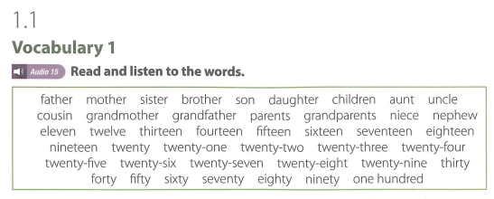
UNIT 1: FAMILY

Slide 7
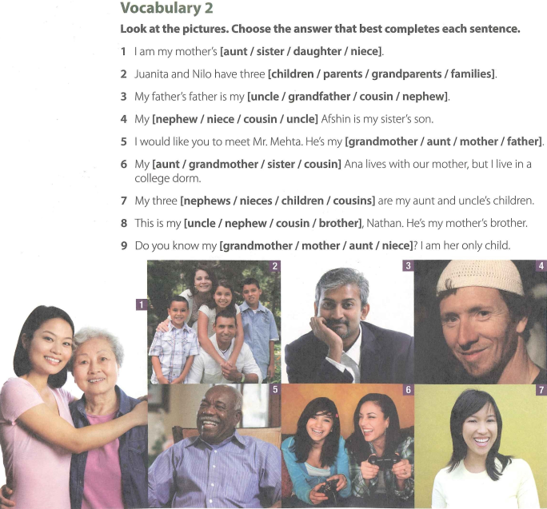

Slide 8
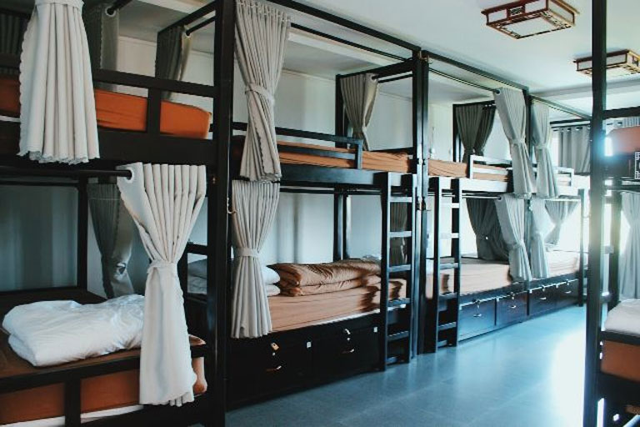
New words:
-> a college dorm

Slide 9
VOCABULARY 2 (KEY)
Look at the pictures. Choose the answer that best completes each sentence.
I am my mother’s [aunt / sister / daughter / niece].
Juanita and Nilo have three [children / parents / grandparents / families].
My father’s father is my [uncle / grandfather / cousin / nephew].
My [nephew / niece / cousin / uncle] Afshin is my sister’s son.
I would like you to meet Mr. Mehta. He’s my [grandmother / aunt / mother / father].
My [aunt / grandmother / sister / cousin] Ana lives with our mother, but I live in a college dorm.
My three [nephews / nieces / children / cousins] are my aunt and uncle’s children.
This is my [uncle / nephew / cousin / brother], Nathan. He’s my mother's brother.
Do you know my [grandmother / mother / aunt / niece]? I am her only child.

Slide 10
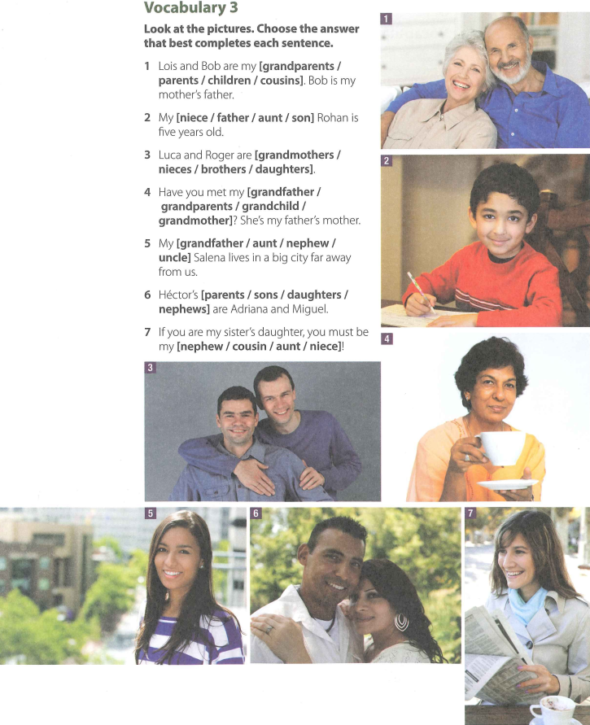

Slide 11
VOCABULARY 3 (KEY)
1 Lois and Bob are my [grandparents / parents / children / cousins]. Bob is my mother’s father.
2 My [niece / father / aunt / son] Rohan is five years old.
3 Luca and Roger are [grandmothers / nieces / brothers / daughters].
4 Have you met my [grandfather / grandparents / grandchild / grandmother]? She’s my father’s mother.
5 My [grandfather / aunt / nephew / uncle] Salena lives in a big city far away from us.
6 Héctor’s [parents / sons / daughters / nephews] are Adriana and Miguel.
7 If you are my sister’s daughter, you must be my [nephew / cousin / aunt / niece]!

Slide 12
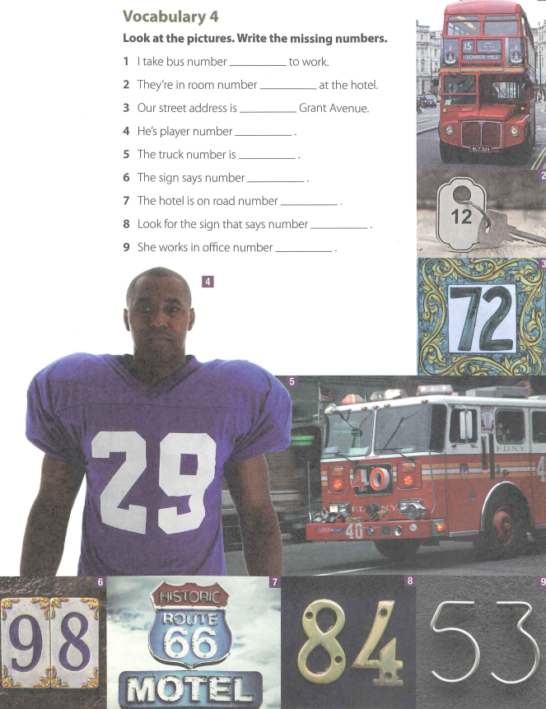

Slide 13
VOCABULARY 4 (KEY)
Look at the pictures. Write the missing numbers.
I take bus number 15 to work.
They’re in room number 12 at the hotel.
Our street address is 72 Grant Avenue.
He's player number 29.
The truck number is 40.
The sign says number 98.
The hotel is on road number 66.
Look for the sign that says number 84.
She works in office number 53.

Slide 14
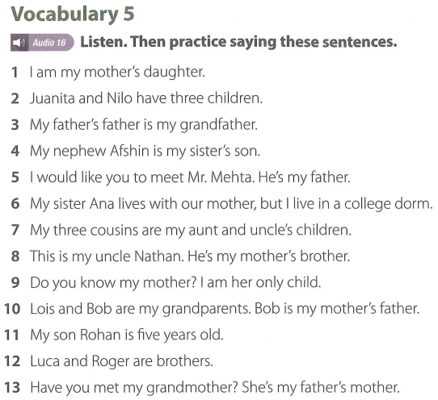

Slide 15
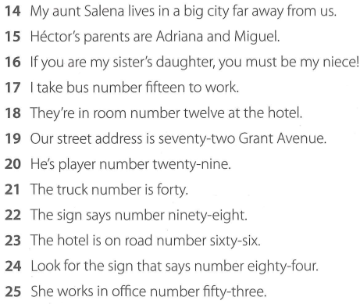

Slide 16
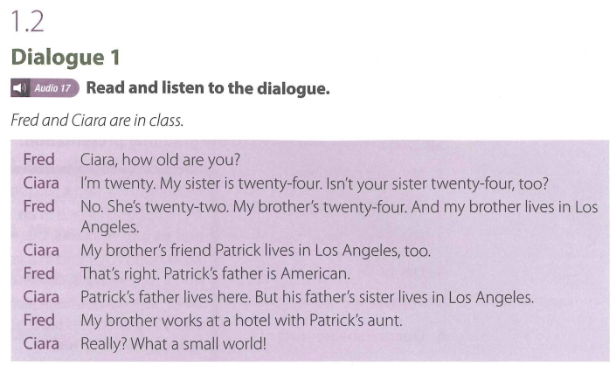

Slide 17
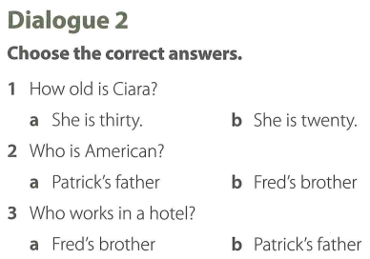

Slide 18
Dialogue 2 (Key)
1. How old is Ciara?
a. She is thirty.
b. She is twenty.
2. Who is American ?
a. Patrick's father
b. Fred’s brother
3. Who works in a hotel?
a. Fred’s brother
b. Patrick's father

Slide 19

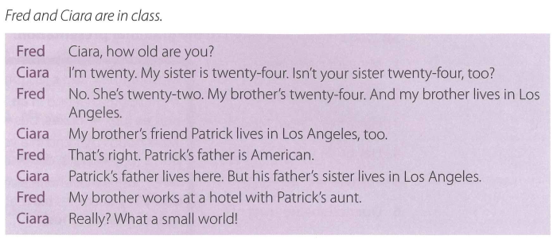

Slide 20
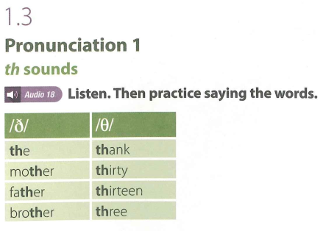

Slide 21
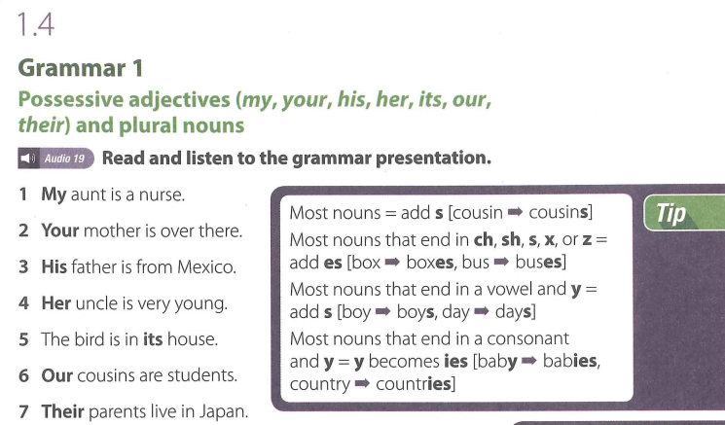

Slide 22
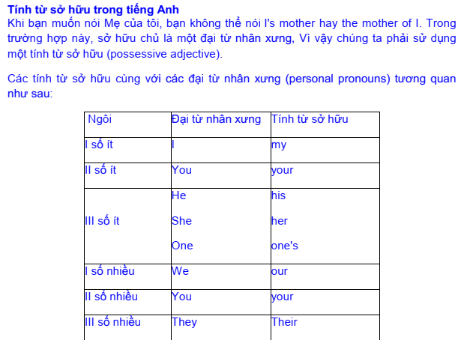

Slide 23
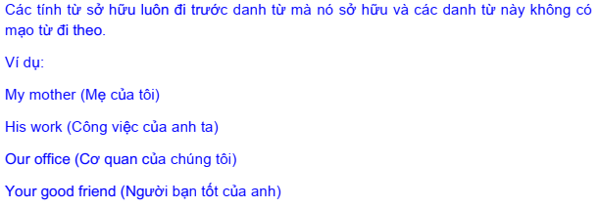

Slide 24
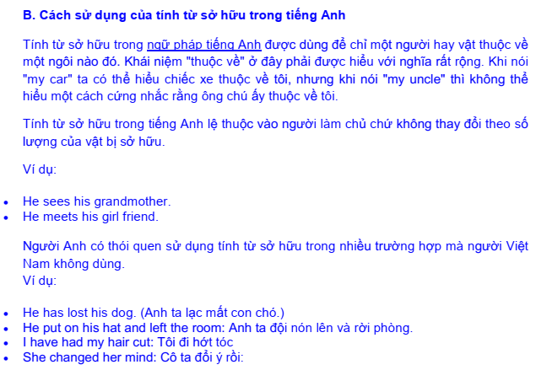

Slide 25
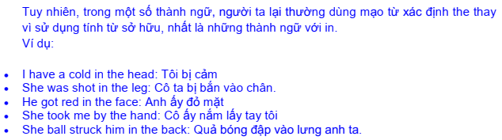

Slide 26
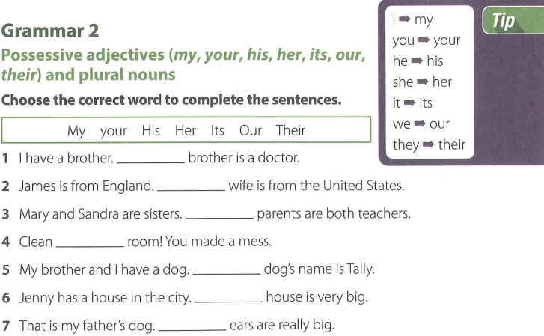

Slide 27
GRAMMAR 2 (KEY)
I have a brother. My brother is a doctor.
James is from England.His wife is from the United States.
Mary and Sandra are sisters.Their parents are both teachers.
Clean your room! You made a mess.
My brother and I have a dog.Our dog’s name is Tally.
Jenny has a house in the city. Her house is very big.
That is my father’s dog. Its ears are really big.

Slide 28
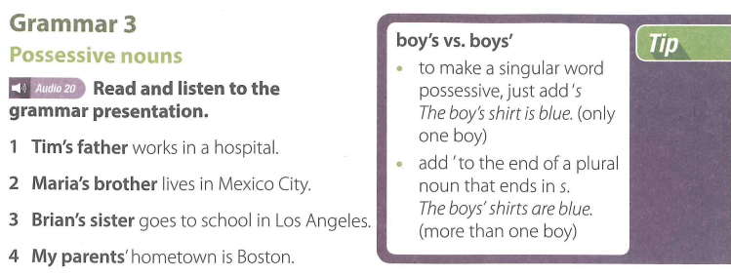

Slide 29
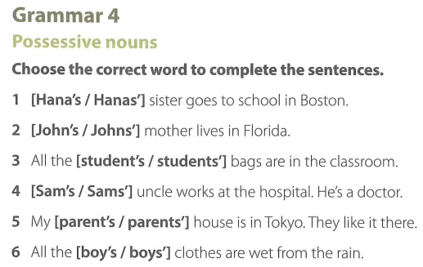

Slide 30
GRAMMAR 4 (KEY)
[Hana’s / Hanas’] sister goes to school in Boston.
[John’s / Johns’] mother lives in Florida.
All the [student’s / students’] bags are in the classroom.
[Sam’s / Sams’] uncle works at the hospital. He’s a doctor.
My [parent’s / parents’] house is in Tokyo. They like it there.
All the [boy’s / boys’] clothes are wet from the rain.

Slide 31
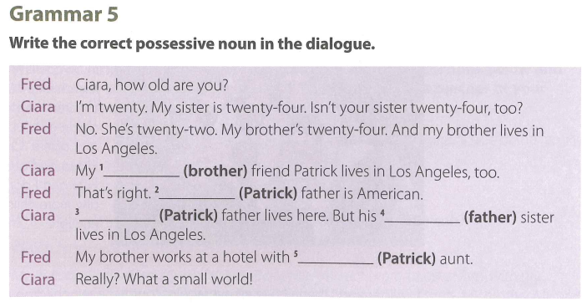

Slide 32
GRAMMAR 5 (KEY)
Fred: Ciara, how old are you?
Ciara: I'm twenty. My sister is twenty-four. Isn't your sister twenty-four, too?
Fred: No. She’s twenty-two. My brother’s twenty-four. And my brother lives in Los Angeles.
Ciara: My brother's friend Patrick lives in Los Angeles, too.
Fred: That’s right. Patrick’s father is American.
Ciara: Patrick’s father lives here. But his father’s sister lives in Los Angeles.
Fred: My brother works at a hotel with Patrick’s aunt.
Ciara: Really? What a small world!

Slide 33
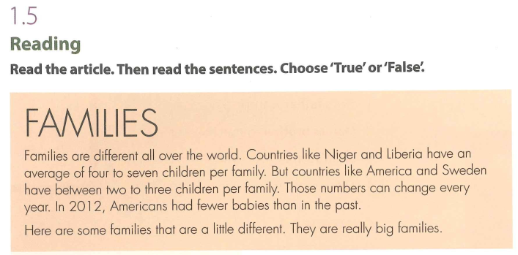

Slide 34
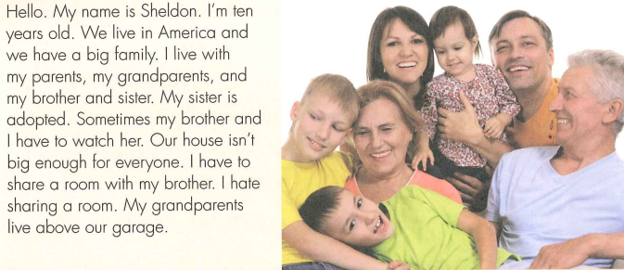

Slide 35
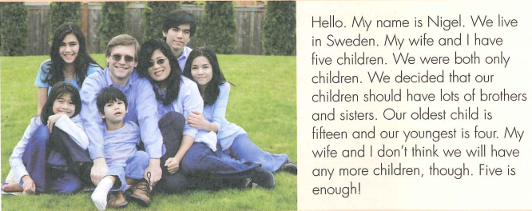

Slide 36
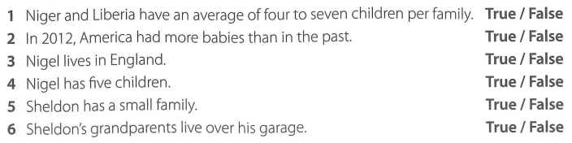

Slide 37
New words:
adopted (adj):
An adopted child has been legally taken by another family to be taken care of as their own child:
Ex: They've got two adopted children and one of their own.

Slide 38
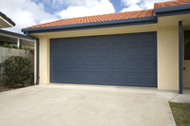
2. garage (n) UK /ˈɡær.ɑːʒ/ /ˈɡær.ɪdʒ/ US /ɡəˈrɑːʒ/
a building where a car is kept, built next to or as part of a house:
Ex: Did you put the car in the garage?

Slide 39
3. average (n) UK /ˈæv.ər.ɪdʒ/ US /ˈæv.ɚ.ɪdʒ/
the result you get by adding two or more amounts together and dividing the total by the number of amounts:
Exs: - The average of the three numbers 7, 12, and 20 is 13, because the total of 7, 12, and 20 is 39, and 39 divided by 3 is 13.
- My income's rather variable, but I earn £175 a day on average.

Slide 40
1.5 Reading (Key)
1. Niger and Liberia have an average of four to seven children per family. True / False
2. In 2012, America had more babies than in the past. True / False
3. Nigel lives in England. True / False
4. Nigel has five children. True / False
5. Sheldon has a small family. True / False
6. Sheldon’s grandparents live over his garage. True / False

Slide 41
Thank you very much
for
your cooperation.

